Slide 1
Task schedulE
"Efficient Workflow Management: Mastering Task Scheduling for Optimal Productivity"

Slide 2
TEAM MEMBERS
Alishba
Tooba (Leader)
Rimsha

Slide 3
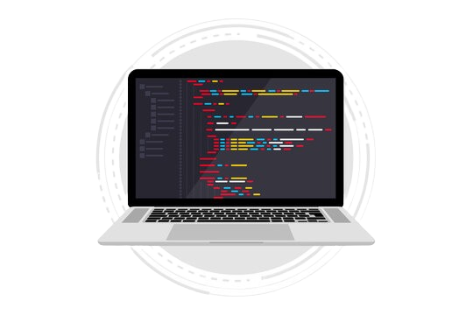
What is Task Schedule
Certainly! Here's a brief description of Task Schedule:
Task scheduling involves planning and organizing activities or automated processes to achieve goals and meet deadlines efficiently. It's essential in computing for optimizing resource use and managing dependencies in various applications, such as operating systems and automation tools.

Slide 4
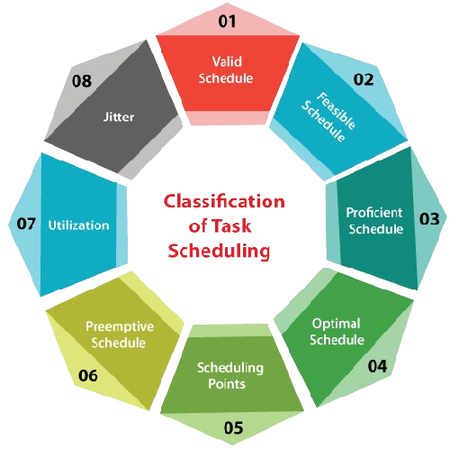
What is Real life application
"The real-life application" is a broad term that can refer to the practical use or implementation of a concept, technology, or idea in everyday situations. It signifies the tangible and beneficial use of knowledge, skills, or products to address real-world problems or improve efficiency in various fields such as technology, medicine, education, and more. Real-life applications often emphasize the practical utility and impact of theories or innovations in solving actual challenges and enhancing the quality of life for individuals or society as a whole.

Slide 5
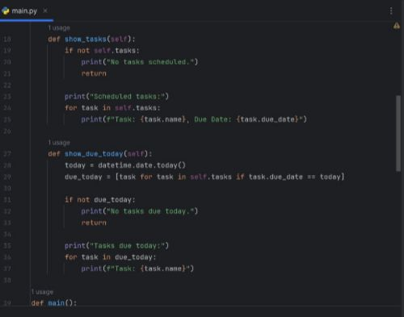
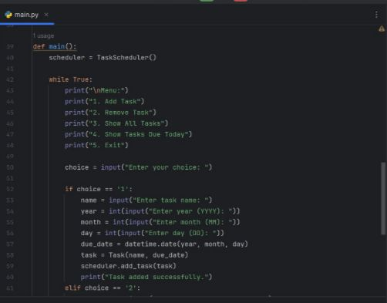
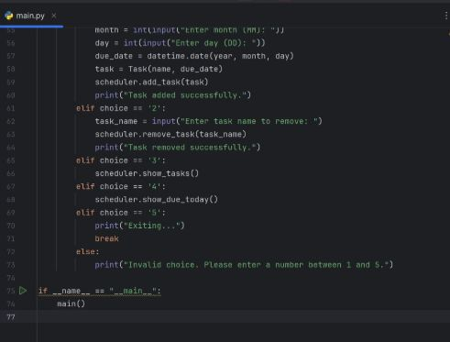
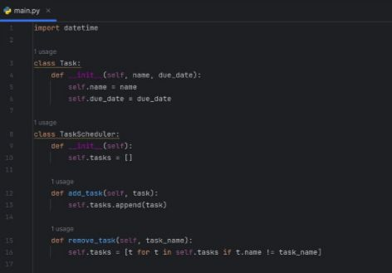
WHAT IS CODING

Slide 6
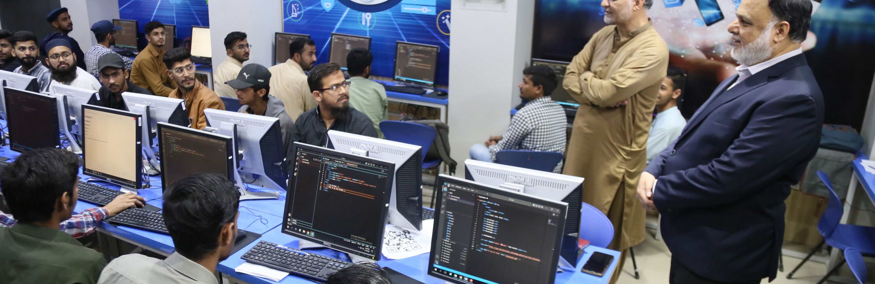
Reviews
Explore the experiences and insights of professionals in the realm of information technology who champion open-source software.

